Slide 1
Computer Systems:
A Programmer’s Perspective
计算机系统详解
Lecture 5
Code Optimization
October 14, 2011
Wu junmin (jmwu@ustc.edu.cn)

Slide 2
Overview
Machine-Independent Optimizations
Machine Dependent Optimizations
  Understanding Processor Operations
  Branches and Branch Prediction
Code Profiling & Tuning

Slide 3
Harsh Reality
There’s more to performance than asymptotic complexity
Constant factors matter too!
  Easily see 10:1 performance range depending on how code is written
  Must optimize at multiple levels:
    algorithm, data representations, procedures, and loops
Must understand system to optimize performance
  How programs are compiled and executed
  How to measure program performance and identify bottlenecks
  How to improve performance without destroying code modularity and generality

Slide 4
Optimizing Compilers
Provide efficient mapping of program to machine
  register allocation
  code selection and ordering (scheduling)
  dead code elimination
  eliminating minor inefficiencies
Don’t (usually) improve asymptotic efficiency
  up to programmer to select best overall algorithm
  big-O savings are (often) more important than constant factors
    but constant factors also matter
Have difficulty overcoming “optimization blockers”
  potential memory aliasing
  potential procedure side-effects

Slide 5
Limitations of Optimizing Compilers
Operate under fundamental constraint
  Must not cause any change in program behavior under any possible condition
  Often prevents it from making optimizations when would only affect behavior under pathological conditions.
Behavior that may be obvious to the programmer can be obfuscated by languages and coding styles
  e.g., Data ranges may be more limited than variable types suggest
Most analysis is performed only within procedures
  Whole-program analysis is too expensive in most cases
Most analysis is based only on static information
  Compiler has difficulty anticipating run-time inputs
When in doubt, the compiler must be conservative

Slide 6
Machine-Independent Optimizations
Optimizations that you or the compiler should do regardless of processor / compiler
Code Motion
  Reduce frequency with which computation performed
    If it will always produce same result
    Especially moving code out of loop
for (i = 0; i < n; i++) {
int ni = n*i;
for (j = 0; j < n; j++)
a[ni + j] = b[j];
}
for (i = 0; i < n; i++)
for (j = 0; j < n; j++)
a[n*i + j] = b[j];

Slide 7
Compiler-Generated Code Motion
  Most compilers do a good job with array code + simple loop structures
Code Generated by GCC
for (i = 0; i < n; i++) {
int ni = n*i;
int *p = a+ni;
for (j = 0; j < n; j++)
*p++ = b[j];
}
for (i = 0; i < n; i++)
for (j = 0; j < n; j++)
a[n*i + j] = b[j];
imull %ebx,%eax # i*n
movl 8(%ebp),%edi # a
leal (%edi,%eax,4),%edx # p = a+i*n (scaled by 4)
# Inner Loop
.L40:
movl 12(%ebp),%edi # b
movl (%edi,%ecx,4),%eax # b+j (scaled by 4)
movl %eax,(%edx) # *p = b[j]
addl $4,%edx # p++ (scaled by 4)
incl %ecx # j++
cmpl %ebx,%ecx
jl .L40 # loop if j<n

Slide 8
Reduction in Strength
  Replace costly operation with simpler one
  Shift, add instead of multiply or divide
    16*x --> x << 4
    Utility machine dependent
    Depends on cost of multiply or divide instruction
    On Pentium II or III, integer multiply only requires 4 CPU cycles
  Recognize sequence of products
int ni = 0;
for (i = 0; i < n; i++) {
for (j = 0; j < n; j++)
a[ni + j] = b[j];
ni += n;
}
for (i = 0; i < n; i++)
for (j = 0; j < n; j++)
a[n*i + j] = b[j];

Slide 9
Share Common Subexpressions
  Reuse portions of expressions
  Compilers often not very sophisticated in exploiting arithmetic properties
/* Sum neighbors of i,j */
up = val[(i-1)*n + j];
down = val[(i+1)*n + j];
left = val[i*n + j-1];
right = val[i*n + j+1];
sum = up + down + left + right;
int inj = i*n + j;
up = val[inj - n];
down = val[inj + n];
left = val[inj - 1];
right = val[inj + 1];
sum = up + down + left + right;
3 multiplications: i*n, (i–1)*n, (i+1)*n
1 multiplication: i*n
leal -1(%edx),%ecx # i-1
imull %ebx,%ecx # (i-1)*n
leal 1(%edx),%eax # i+1
imull %ebx,%eax # (i+1)*n
imull %ebx,%edx # i*n

Slide 10
Time Scales
Absolute Time
  Typically use nanoseconds
    10^{–9} seconds
  Time scale of computer instructions
Clock Cycles
  Most computers controlled by high frequency clock signal
  Typical Range
    100 MHz
      10⁸ cycles per second
      Clock period = 10ns
    2 GHz
      2 X 10⁹ cycles per second
      Clock period = 0.5ns

Slide 11
Measuring Performance
For many programs, cycles per element (CPE)
  Especially true of programs that work on lists/vectors
  Total time = fixed overhead + CPE * length-of-list
void vsum2(int n)
{
int i;
for (i = 0; i<n; i+=2){
c[i] = a[i] + b[i];
c[i+1] = a[i+1] + b[i+1];
}
}
void vsum1(int n)
{
int i;
for (i = 0; i<n; i++)
c[i] = a[i] + b[i];
}
vsum2 only works on even n.
vsum2 is an example of loop unrolling.

Slide 12
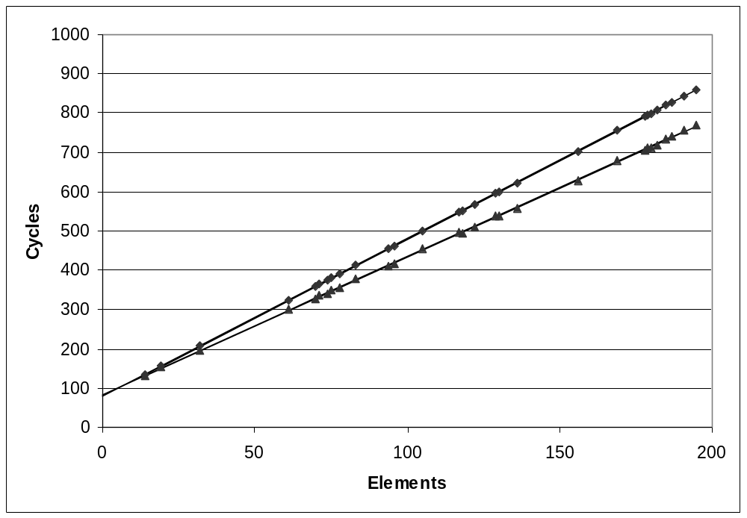
Cycles Per Element
  Convenient way to express performance of program that operators on vectors or lists
  Length = n
  T = CPE*n + Overhead
vsum1
Slope = 4.0
vsum2
Slope = 3.5

Slide 13
Vector Abstract Data Type (ADT)
length
0
1
2
length–1
data
• • •
Procedures
  vec_ptr new_vec(int len)
    Create vector of specified length
  int get_vec_element(vec_ptr v, int index, int *dest)
    Retrieve vector element, store at *dest
    Return 0 if out of bounds, 1 if successful
  int *get_vec_start(vec_ptr v)
    Return pointer to start of vector data
  Similar to array implementations in Pascal, ML, Java
    E.g., always do bounds checking

Slide 14
Optimization Example
void combine1(vec_ptr v, int *dest)
{
int i;
*dest = 0;
for (i = 0; i < vec_length(v); i++) {
int val;
get_vec_element(v, i, &val);
*dest += val;
}
}
Procedure
  Compute sum of all elements of integer vector
  Store result at destination location
  Vector data structure and operations defined via abstract data type
Pentium III Performance: Clock Cycles / Element
  42.06 (Compiled -g) 31.25 (Compiled -O2)

Slide 15
Understanding Loops
void combine1-goto(vec_ptr v, int *dest)
{
int i = 0;
int val;
*dest = 0;
loop:
if (i >= vec_length(v))
goto done;
get_vec_element(v, i, &val);
*dest += val;
i++;
goto loop;
done:
}
1 iteration
Inefficiency
  Procedure vec_length called every iteration
  Even though result always the same

Slide 16
Move vec_length Call Out of Loop
void combine2(vec_ptr v, int *dest)
{
int i;
int length = vec_length(v);
*dest = 0;
for (i = 0; i < length; i++) {
int val;
get_vec_element(v, i, &val);
*dest += val;
}
}
Optimization
  Move call to vec_length out of inner loop
    Value does not change from one iteration to next
    Code motion
  CPE: 20.66 (Compiled -O2)
    vec_length requires only constant time, but significant overhead

Slide 17
Code Motion Example #2
Procedure to Convert String to Lower Case
  Extracted from 213 lab submissions, Fall, 1998
void lower(char *s)
{
int i;
for (i = 0; i < strlen(s); i++)
if (s[i] >= 'A' && s[i] <= 'Z')
s[i] -= ('A' - 'a');
}

Slide 18
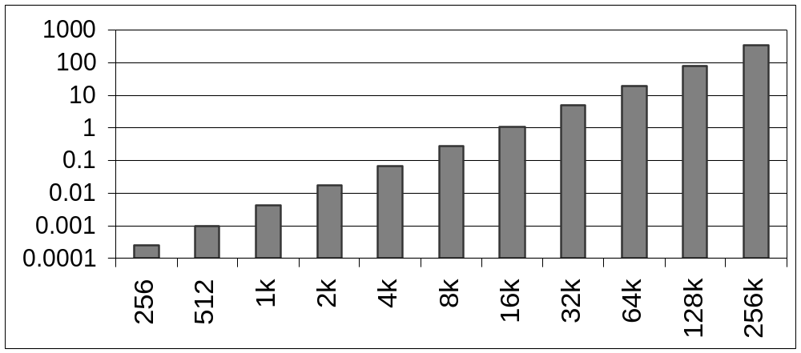
Lower Case Conversion Performance
  Time quadruples when double string length
  Quadratic performance of lower
CPU Seconds
String Length

Slide 19
Convert Loop To Goto Form
  strlen executed every iteration
  strlen linear in length of string
    Must scan string until finds '\0'
  Overall performance is quadratic
void lower(char *s)
{
int i = 0;
if (i >= strlen(s))
goto done;
loop:
if (s[i] >= 'A' && s[i] <= 'Z')
s[i] -= ('A' - 'a');
i++;
if (i < strlen(s))
goto loop;
done:
}

Slide 20
Improving Performance
  Move call to strlen outside of loop
  Since result does not change from one iteration to another
  Form of code motion
void lower(char *s)
{
int i;
int len = strlen(s);
for (i = 0; i < len; i++)
if (s[i] >= 'A' && s[i] <= 'Z')
s[i] -= ('A' - 'a');
}

Slide 21
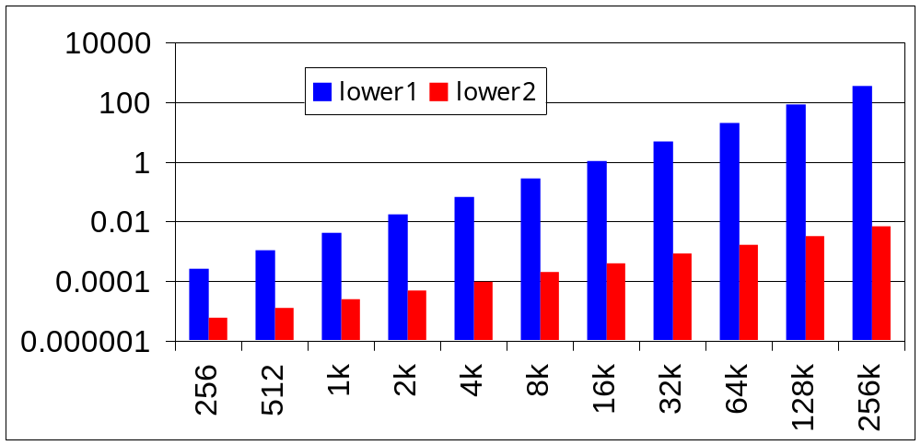
Lower Case Conversion Performance
  Time doubles when double string length
  Linear performance of lower2
CPU Seconds
String Length

Slide 22
Optimization Blocker: Procedure Calls
Why couldn’t compiler move vec_length out of inner loop?
  Procedure may have side effects
    Alters global state each time called
  Function may not return same value for given arguments
    Depends on other parts of global state
    Procedure lower could interact with strlen
Why doesn’t compiler look at code for vec_length?
  Interprocedural optimization is not used extensively due to cost
Warning:
  Compiler treats procedure call as a black box
  Weak optimizations in and around them
Remedies:
  Use of inline functions
  Use of macros (careful: can obfuscate code!)

Slide 23
Reduction in Strength
void combine3(vec_ptr v, int *dest)
{
int i;
int length = vec_length(v);
int *data = get_vec_start(v);
*dest = 0;
for (i = 0; i < length; i++) {
*dest += data[i];
}
Optimization
  Avoid procedure call to retrieve each vector element
    Get pointer to start of array before loop
    Within loop just do pointer reference
    Not as clean in terms of data abstraction
  CPE: 6.00 (Compiled -O2)
    Procedure calls are expensive!
    Bounds checking is expensive

Slide 24
Eliminate Unneeded Memory Refs
Optimization
  Don’t need to store in destination until end
  Local variable sum held in register
  Avoids 1 memory read, 1 memory write per element
  CPE: 2.00 (Compiled -O2)
    Memory references are expensive!
void combine4(vec_ptr v, int *dest)
{
int i;
int length = vec_length(v);
int *data = get_vec_start(v);
int sum = 0;
for (i = 0; i < length; i++)
sum += data[i];
*dest = sum;
}

Slide 25
Detecting Unneeded Memory Refs.
Combine3
Combine4
.L18:
movl (%ecx,%edx,4),%eax
addl %eax,(%edi)
incl %edx
cmpl %esi,%edx
jl .L18
.L24:
addl (%eax,%edx,4),%ecx
incl %edx
cmpl %esi,%edx
jl .L24
Performance
  Combine3
    5 instructions in 6 clock cycles
    addl must read and write memory
  Combine4
    4 instructions in 2 clock cycles

Slide 26
Optimization Blocker: Memory Aliasing
Aliasing
  Two different memory references specify single location
Example
  v: [3, 2, 17]
  combine3(v, get_vec_start(v)+2) --> ?
  combine4(v, get_vec_start(v)+2) --> ?
Observations
  Easy to have happen in C
    Since allowed to do address arithmetic
    Direct access to storage structures
  Get in habit of introducing local variables
    Accumulating within loops
    Your way of telling compiler not to check for aliasing

Slide 27
General Forms of Combining
void abstract_combine4(vec_ptr v, data_t *dest)
{
int i;
int length = vec_length(v);
data_t *data = get_vec_start(v);
data_t t = IDENT;
for (i = 0; i < length; i++)
t = t OP data[i];
*dest = t;
}
Data Types
  Use different declarations for data_t
  int
  float
  double
Operations
  Use different definitions of OP and IDENT
  + / 0
  * / 1

Slide 28
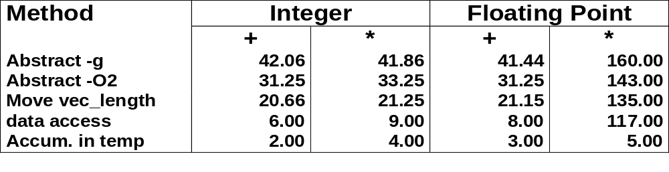
Machine Independent Opt. Results
Optimizations
  Reduce function calls and memory references within loop
Performance Anomaly
  Computing FP product of all elements exceptionally slow.
  Very large speedup when accumulate in temporary
  Caused by quirk of IA32 floating point
    Memory uses 64-bit format, register use 80
    Benchmark data caused overflow of 64 bits, but not 80

Slide 29
Pointer Code
void combine4p(vec_ptr v, int *dest)
{
int length = vec_length(v);
int *data = get_vec_start(v);
int *dend = data+length;
int sum = 0;
while (data < dend)
sum += *data++;
*dest = sum;
}
Optimization
  Use pointers rather than array references
  CPE: 3.00 (Compiled -O2)
    Oops! We’re not making progress here!
  Warning: Some compilers do better job optimizing
  array code

Slide 30
Pointer vs. Array Code Inner Loops
Array Code
Pointer Code
Performance
  Array Code: 4 instructions in 2 clock cycles
  Pointer Code: Almost same 4 instructions in 3 clock cycles
.L24: # Loop:
addl (%eax,%edx,4),%ecx # sum += data[i]
incl %edx # i++
cmpl %esi,%edx # i:length
jl .L24 # if < goto Loop
.L30: # Loop:
addl (%eax),%ecx # sum += *data
addl $4,%eax # data ++
cmpl %edx,%eax # data:dend
jb .L30 # if < goto Loop

Slide 31
Machine-Independent Opt. Summary
Code Motion
  Compilers are good at this for simple loop/array structures
  Don’t do well in the presence of procedure calls and memory aliasing
Reduction in Strength
  Shift, add instead of multiply or divide
    Compilers are (generally) good at this
    Exact trade-offs machine-dependent
  Keep data in registers (local variables) rather than memory
    Compilers are not good at this, since concerned with aliasing
    Compilers do know how to allocate registers (no need for register declaration)
Share Common Subexpressions
  Compilers have limited algebraic reasoning capabilities

Slide 32
Overview
Machine-Independent Optimizations
Machine Dependent Optimizations
  Understanding Processor Operations
  Branches and Branch Prediction
Code Profiling & Tuning

Slide 33
Modern CPU Design
Instruction Control
Fetch
Control
Address
Retirement
Unit
Instruction
Cache
Register
File
Instruction
Decode
Instrs.
Operations
Register Updates
Prediction OK?
Execution
Functional
Units
Integer/
Branch
General
Integer
FP
Add
FP
Mult/Div
Load
Store
Operation Results
Addr.
Addr.
Data
Data
Data
Cache

Slide 34
CPU Capabilities of Pentium III
Multiple Instructions Can Execute in Parallel
  1 load
  1 store
  2 integer (one may be branch)
  1 FP Addition
  1 FP Multiplication or Division
Some Instructions Take > 1 Cycle, but Can be Pipelined
  Instruction Latency Cycles/Issue
  Load / Store 3 1
  Integer Multiply 4 1
  Integer Divide 36 36
  Double/Single FP Multiply 5 2
  Double/Single FP Add 3 1
  Double/Single FP Divide 38 38

Slide 35
Instruction Control
Instruction Control
Fetch
Control
Address
Retirement
Unit
Instruction
Cache
Register
File
Instruction
Decode
Instrs.
Operations
Grabs Instruction Bytes From Memory
  Based on current PC + predicted targets for predicted branches
  Hardware dynamically guesses whether branches taken/not taken and (possibly) branch target
Translates Instructions Into Operations (for CISC style CPUs)
  Primitive steps required to perform instruction
  Typical instruction requires 1–3 operations
Converts Register References Into Tags
  Abstract identifier linking destination of one operation with sources of later operations

Slide 36
Translation Example
Version of Combine4
  Integer data, multiply operation
Translation of First Iteration
.L24: # Loop:
imull (%eax,%edx,4),%ecx # t *= data[i]
incl %edx # i++
cmpl %esi,%edx # i:length
jl .L24 # if < goto Loop
.L24:
imull (%eax,%edx,4),%ecx
incl %edx
cmpl %esi,%edx
jl .L24
load (%eax,%edx.0,4) ➔ t.1
imull t.1, %ecx.0 ➔ %ecx.1
incl %edx.0 ➔ %edx.1
cmpl %esi, %edx.1 ➔ cc.1
jl-taken cc.1

Slide 37
Translation Example #1
imull (%eax,%edx,4),%ecx
load (%eax,%edx.0,4) ➔ t.1
imull t.1, %ecx.0 ➔ %ecx.1
  Split into two operations
    load reads from memory to generate temporary result t.1
    Multiply operation just operates on registers
  Operands
    Register %eax does not change in loop. Values will be retrieved from register file during decoding
    Register %ecx changes on every iteration. Uniquely identify different versions as %ecx.0, %ecx.1, %ecx.2, …
      Register renaming
      Values passed directly from producer to consumers (bypass hardware)

Slide 38
Translation Example #2
incl %edx
incl %edx.0 ➔ %edx.1
  Register %edx changes on each iteration. Rename as %edx.0, %edx.1, %edx.2, …

Slide 39
Translation Example #3
cmpl %esi,%edx
cmpl %esi, %edx.1 ➔ cc.1
  Condition codes are treated similar to registers
  Assign tag to define connection between producer and consumer

Slide 40
Translation Example #4
jl .L24
jl-taken cc.1
  Instruction control unit determines destination of jump
  Predicts whether will be taken and target
  Starts fetching instruction at predicted destination
  Execution unit simply checks whether or not prediction was OK
  If not, it signals instruction control
    Instruction control then “invalidates” any operations generated from misfetched instructions
    Begins fetching and decoding instructions at correct target

Slide 41
Visualizing Operations
%edx.0
load (%eax,%edx,4) ➔ t.1
imull t.1, %ecx.0 ➔ %ecx.1
incl %edx.0 ➔ %edx.1
cmpl %esi, %edx.1 ➔ cc.1
jl-taken cc.1
load
incl
%edx.1
cmpl
cc.1
%ecx.0
jl
t.1
imull
Time
Operations
  Vertical position denotes time at which executed
    Cannot begin operation until operands available
  Height denotes latency
Operands
  Arcs shown only for operands that are passed within execution unit
%ecx.1

Slide 42
Visualizing Operations (cont.)
load (%eax,%edx,4) ➔ t.1
iaddl t.1, %ecx.0 ➔ %ecx.1
incl %edx.0 ➔ %edx.1
cmpl %esi, %edx.1 ➔ cc.1
jl-taken cc.1
%edx.0
load
load
incl
%edx.1
%ecx.i +1
cmpl
cc.1
%ecx.0
jl
Operations
  Same as before, except that add has latency of 1
Time
t.1
addl
%ecx.1

Slide 43
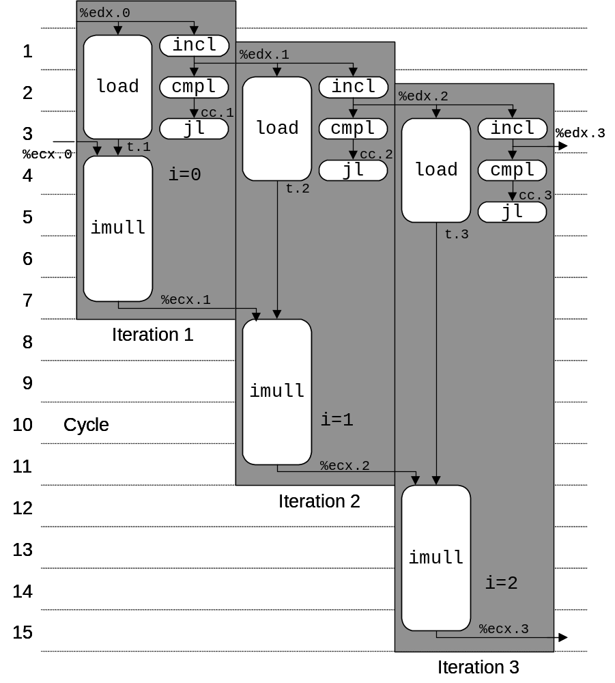
3 Iterations of Combining Product
Unlimited Resource Analysis
  Assume operation can start as soon as operands available
  Operations for multiple iterations overlap in time
Performance
  Limiting factor becomes latency of integer multiplier
  Gives CPE of 4.0

Slide 44
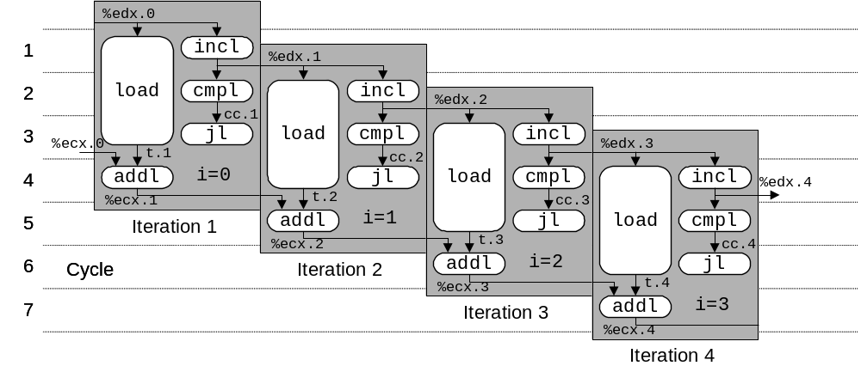
4 Iterations of Combining Sum
4 integer ops
Unlimited Resource Analysis
Performance
  Can begin a new iteration on each clock cycle
  Should give CPE of 1.0
  Would require executing 4 integer operations in parallel

Slide 45
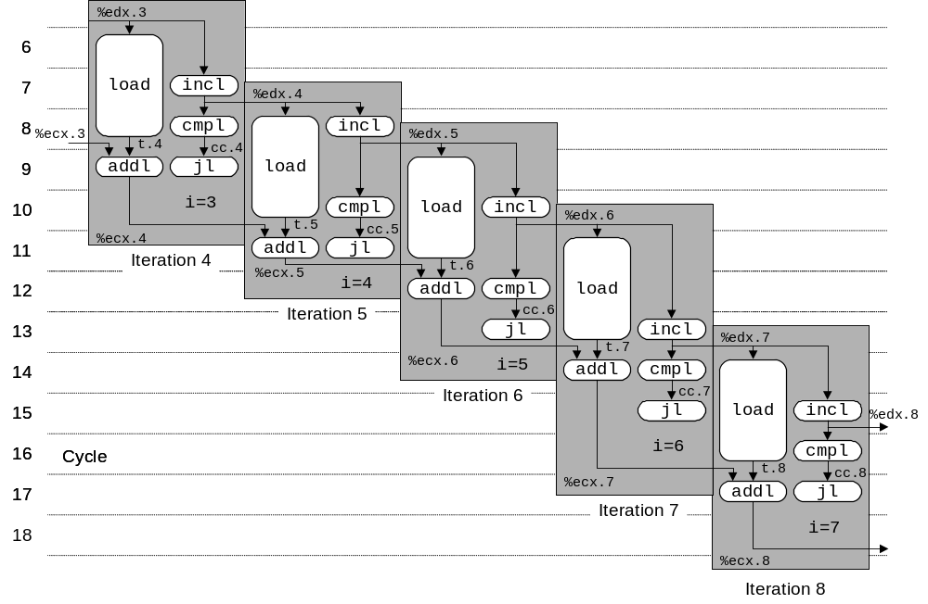
Combining Sum: Resource Constraints
  Only have two integer functional units
  Some operations delayed even though operands available
  Set priority based on program order
Performance
  Sustain CPE of 2.0

Slide 46
Loop Unrolling
void combine5(vec_ptr v, int *dest)
{
int length = vec_length(v);
int limit = length-2;
int *data = get_vec_start(v);
int sum = 0;
int i;
/* Combine 3 elements at a time */
for (i = 0; i < limit; i+=3) {
sum += data[i] + data[i+2]
+ data[i+1];
}
/* Finish any remaining elements */
for (; i < length; i++) {
sum += data[i];
}
*dest = sum;
}
Optimization
  Combine multiple iterations into single loop body
  Amortizes loop overhead across multiple iterations
  Finish extras at end
  Measured CPE = 1.33

Slide 47
Visualizing Unrolled Loop
  Loads can pipeline, since don’t have dependencies
  Only one set of loop control operations
%edx.0
load
addl
%edx.1
load
%ecx.i +1
cmpl
cc.1
load
jl
%ecx.0c
t.1a
addl
%ecx.1a
t.1b
Time
addl
%ecx.1b
t.1c
load (%eax,%edx.0,4) ➔ t.1a
iaddl t.1a, %ecx.0c ➔ %ecx.1a
load 4(%eax,%edx.0,4) ➔ t.1b
iaddl t.1b, %ecx.1a ➔ %ecx.1b
load 8(%eax,%edx.0,4) ➔ t.1c
iaddl t.1c, %ecx.1b ➔ %ecx.1c
iaddl $3,%edx.0 ➔ %edx.1
cmpl %esi, %edx.1 ➔ cc.1
jl-taken cc.1
addl
%ecx.1c

Slide 48
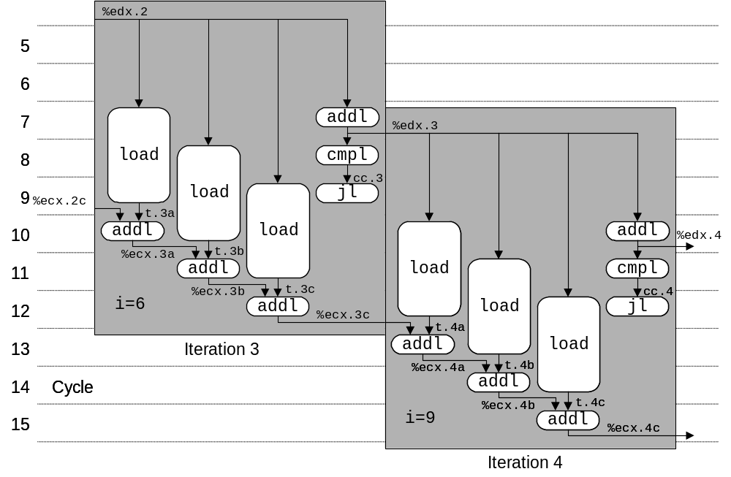
Executing with Loop Unrolling
  Predicted Performance
    Can complete iteration in 3 cycles
    Should give CPE of 1.0
  Measured Performance
    CPE of 1.33
    One iteration every 4 cycles

Slide 49
Effect of Unrolling
Unrolling Degree |  | 1 | 2 | 3 | 4 | 8 | 16
Integer | Sum | 2.00 | 1.50 | 1.33 | 1.50 | 1.25 | 1.06
Integer | Product | 4.00
FP | Sum | 3.00
FP | Product | 5.00
  Only helps integer sum for our examples
    Other cases constrained by functional unit latencies
  Effect is nonlinear with degree of unrolling
    Many subtle effects determine exact scheduling of operations

Slide 50
Serial Computation
1
x₀
*
x₁
Computation
  ((((((((((((1 * x0) * x1) * x2) * x3) * x4) * x5) * x6) * x7) * x8) * x9) * x10) * x11)
Performance
  N elements, D cycles/operation
  N*D cycles
*
x₂
*
x₃
*
x₄
*
x₅
*
x₆
*
x₇
*
x₈
*
x₉
*
x₁₀
*
x₁₁
*

Slide 51
Parallel Loop Unrolling
void combine6(vec_ptr v, int *dest)
{
int length = vec_length(v);
int limit = length-1;
int *data = get_vec_start(v);
int x0 = 1;
int x1 = 1;
int i;
/* Combine 2 elements at a time */
for (i = 0; i < limit; i+=2) {
x0 *= data[i];
x1 *= data[i+1];
}
/* Finish any remaining elements */
for (; i < length; i++) {
x0 *= data[i];
}
*dest = x0 * x1;
}
Code Version
  Integer product
Optimization
  Accumulate in two different products
    Can be performed simultaneously
  Combine at end
  2-way parallism
Performance
  CPE = 2.0
  2X performance

Slide 52
Dual Product Computation
Computation
  ((((((1 * x₀) * x₂) * x₄) * x₆) * x₈) * x₁₀) *
  ((((((1 * x₁) * x₃) * x₅) * x₇) * x₉) * x₁₁)
Performance
  N elements, D cycles/operation
  (N/2+1)*D cycles
  ~2X performance improvement
1
x₀
1
x₁
*
x₂
*
x₃
*
x₄
*
x₅
*
x₆
*
x₇
*
x₈
*
x₉
*
x₁₀
*
x₁₁
*
*
*

Slide 53
Requirements for Parallel Computation
Mathematical
  Combining operation must be associative & commutative
    OK for integer multiplication
    Not strictly true for floating point
      OK for most applications
Hardware
  Pipelined functional units
  Ability to dynamically extract parallelism from code

Slide 54
Visualizing Parallel Loop
  Two multiplies within loop no longer have data depency
  Allows them to pipeline
%edx.0
load
addl
%edx.1
load
cmpl
cc.1
%ecx.0
jl
t.1a
%ebx.0
imull
t.1b
imull
Time
load (%eax,%edx.0,4) ➔ t.1a
imull t.1a, %ecx.0 ➔ %ecx.1
load 4(%eax,%edx.0,4) ➔ t.1b
imull t.1b, %ebx.0 ➔ %ebx.1
iaddl $2,%edx.0 ➔ %edx.1
cmpl %esi, %edx.1 ➔ cc.1
jl-taken cc.1
%ecx.1
%ebx.1

Slide 55
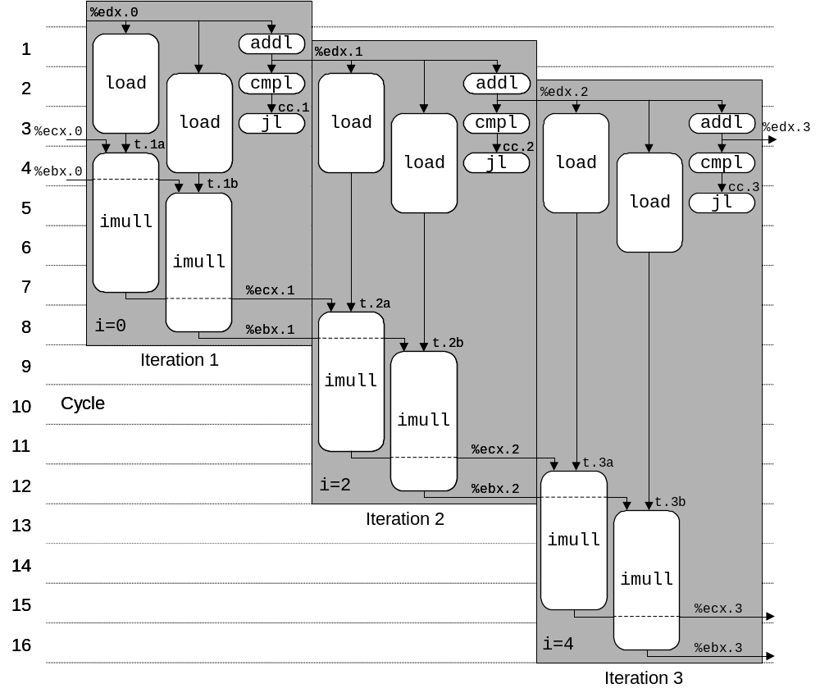
Executing with Parallel Loop
  Predicted Performance
    Can keep 4-cycle multiplier busy performing two simultaneous multiplications
    Gives CPE of 2.0

Slide 56
Parallel Unrolling: Method #2
void combine6aa(vec_ptr v, int *dest)
{
int length = vec_length(v);
int limit = length-1;
int *data = get_vec_start(v);
int x = 1;
int i;
/* Combine 2 elements at a time */
for (i = 0; i < limit; i+=2) {
x *= (data[i] * data[i+1]);
}
/* Finish any remaining elements */
for (; i < length; i++) {
x *= data[i];
}
*dest = x;
}
Code Version
  Integer product
Optimization
  Multiply pairs of elements together
  And then update product
  “Tree height reduction”
Performance
  CPE = 2.5

Slide 57
Method #2 Computation
Computation
  ((((((1 * (x0 * x1)) * (x2 * x3)) * (x4 * x5)) * (x6 * x7)) * (x8 * x9)) * (x10 * x11))
Performance
  N elements, D cycles/operation
  Should be (N/2+1)*D cycles
    CPE = 2.0
  Measured CPE worse
x₀
x₁
1
*
x₂
x₃
*
*
x₄
x₅
*
*
x₆
x₇
*
*
x₈
x₉
Unrolling | CPE (measured) | CPE (theoretical)
2 | 2.50 | 2.00
3 | 1.67 | 1.33
4 | 1.50 | 1.00
6 | 1.78 | 1.00
*
*
x₁₀
x₁₁
*
*
*

Slide 58
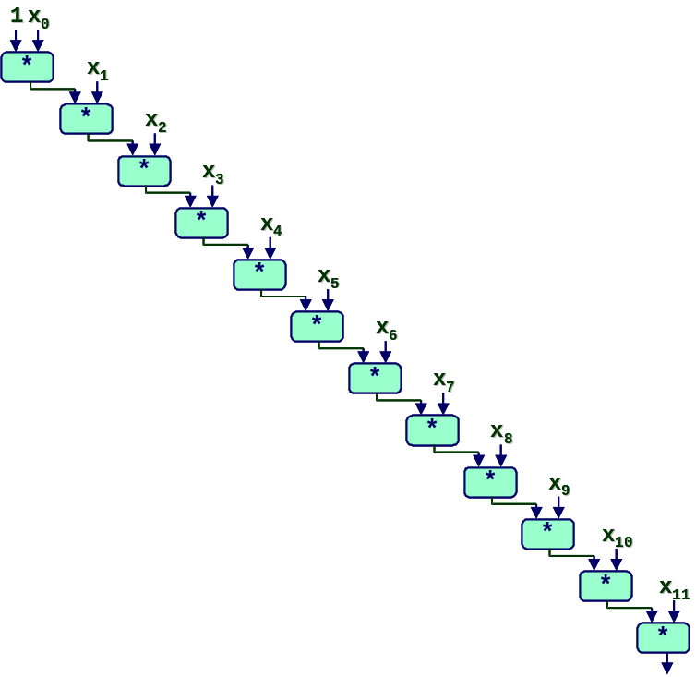
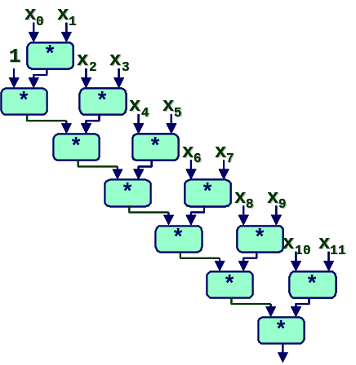
Understanding Parallelism
/* Combine 2 elements at a time */
for (i = 0; i < limit; i+=2) {
x = (x * data[i]) * data[i+1];
}
  CPE = 4.00
  All multiplies perfomed in sequence
/* Combine 2 elements at a time */
for (i = 0; i < limit; i+=2) {
x = x * (data[i] * data[i+1]);
}
  CPE = 2.50
  Multiplies overlap

Slide 59
Limitations of Parallel Execution
Need Lots of Registers
  To hold sums/products
  Only 6 usable integer registers
    Also needed for pointers, loop conditions
  8 FP registers
  When not enough registers, must spill temporaries onto stack
    Wipes out any performance gains
  Not helped by renaming
    Cannot reference more operands than instruction set allows
    Major drawback of IA32 instruction set architecture, partially alleviated by recent extensions like SSE, …

Slide 60
Register Spilling Example
.L165:
imull (%eax),%ecx
movl -4(%ebp),%edi
imull 4(%eax),%edi
movl %edi,-4(%ebp)
movl -8(%ebp),%edi
imull 8(%eax),%edi
movl %edi,-8(%ebp)
movl -12(%ebp),%edi
imull 12(%eax),%edi
movl %edi,-12(%ebp)
movl -16(%ebp),%edi
imull 16(%eax),%edi
movl %edi,-16(%ebp)
  …
addl $32,%eax
addl $8,%edx
cmpl -32(%ebp),%edx
jl .L165
Example
  8 X 8 integer product
  7 local variables share 1 register
  See that are storing locals on stack
  E.g., at -8(%ebp)

Slide 61
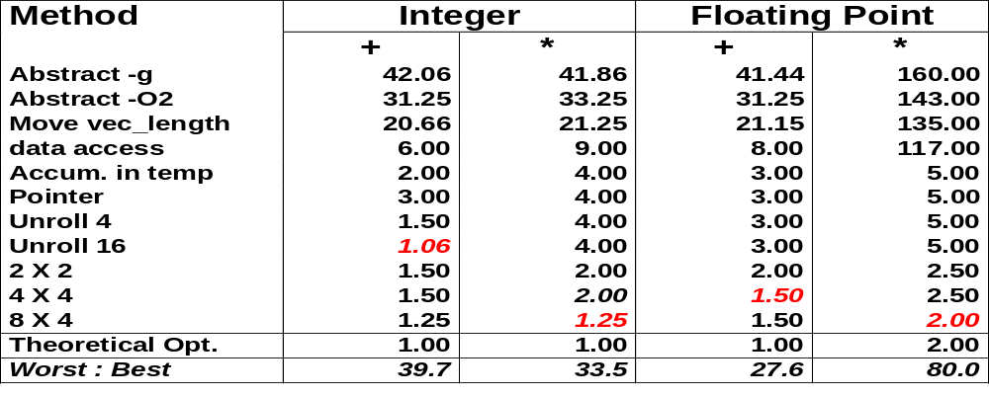
Summary: Results for Pentium III

Slide 62
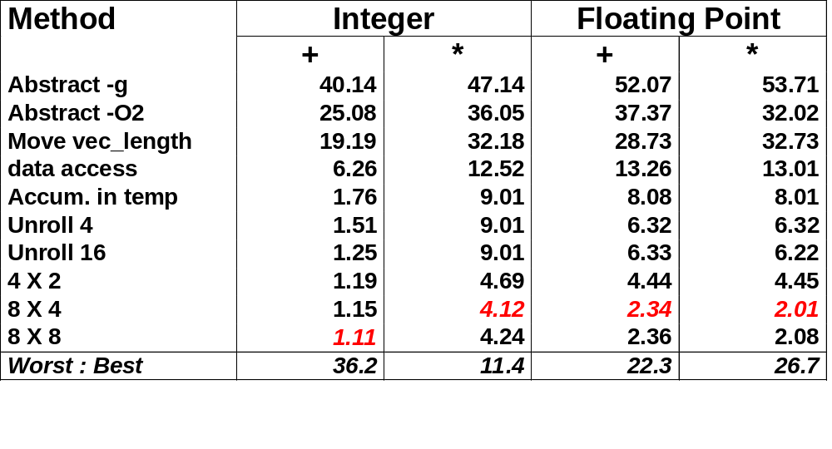
Results for Alpha Processor
  Overall trends very similar to those for Pentium III.
  Even though very different architecture and compiler

Slide 63
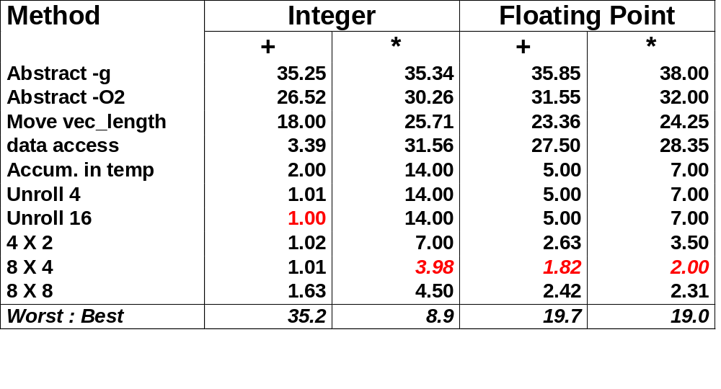
Results for Pentium 4 Processor
  Higher latencies (int * = 14, fp + = 5.0, fp * = 7.0)
    Clock runs at 2.0 GHz
    Not an improvement over 1.0 GHz P3 for integer *
  Avoids FP multiplication anomaly

Slide 64
What About Branches?
Challenge
  Instruction Control Unit must work well ahead of Exec. Unit
    To generate enough operations to keep EU busy
  When encounters conditional branch, cannot reliably determine where to continue fetching
80489f3: movl $0x1,%ecx
80489f8: xorl %edx,%edx
80489fa: cmpl %esi,%edx
80489fc: jnl 8048a25
80489fe: movl %esi,%esi
8048a00: imull (%eax,%edx,4),%ecx
Executing
Fetching &
Decoding

Slide 65
Branch Outcomes
  When encounter conditional branch, cannot determine where to continue fetching
    Branch Taken: Transfer control to branch target
    Branch Not-Taken: Continue with next instruction in sequence
  Cannot resolve until outcome determined by branch/integer unit
80489f3: movl $0x1,%ecx
80489f8: xorl %edx,%edx
80489fa: cmpl %esi,%edx
80489fc: jnl 8048a25
80489fe: movl %esi,%esi
8048a00: imull (%eax,%edx,4),%ecx
Branch Not-Taken
Branch Taken
8048a25: cmpl %edi,%edx
8048a27: jl 8048a20
8048a29: movl 0xc(%ebp),%eax
8048a2c: leal 0xffffffe8(%ebp),%esp
8048a2f: movl %ecx,(%eax)

Slide 66
Branch Prediction
Idea
  Guess which way branch will go
  Begin executing instructions at predicted position
    But don’t actually modify register or memory data
80489f3: movl $0x1,%ecx
80489f8: xorl %edx,%edx
80489fa: cmpl %esi,%edx
80489fc: jnl 8048a25
. . .
Predict Taken
8048a25: cmpl %edi,%edx
8048a27: jl 8048a20
8048a29: movl 0xc(%ebp),%eax
8048a2c: leal 0xffffffe8(%ebp),%esp
8048a2f: movl %ecx,(%eax)
Execute

Slide 67
Branch Prediction Through Loop
80488b1: movl (%ecx,%edx,4),%eax
80488b4: addl %eax,(%edi)
80488b6: incl %edx
80488b7: cmpl %esi,%edx
80488b9: jl 80488b1
Assume vector length = 100
i = 98
Predict Taken (OK)
80488b1: movl (%ecx,%edx,4),%eax
80488b4: addl %eax,(%edi)
80488b6: incl %edx
80488b7: cmpl %esi,%edx
80488b9: jl 80488b1
i = 99
Predict Taken
(Oops)
80488b1: movl (%ecx,%edx,4),%eax
80488b4: addl %eax,(%edi)
80488b6: incl %edx
80488b7: cmpl %esi,%edx
80488b9: jl 80488b1
Executed
Read invalid location
i = 100
Fetched
80488b1: movl (%ecx,%edx,4),%eax
80488b4: addl %eax,(%edi)
80488b6: incl %edx
80488b7: cmpl %esi,%edx
80488b9: jl 80488b1
i = 101

Slide 68
Branch Misprediction Invalidation
80488b1: movl (%ecx,%edx,4),%eax
80488b4: addl %eax,(%edi)
80488b6: incl %edx
80488b7: cmpl %esi,%edx
80488b9: jl 80488b1
Assume vector length = 100
i = 98
Predict Taken (OK)
80488b1: movl (%ecx,%edx,4),%eax
80488b4: addl %eax,(%edi)
80488b6: incl %edx
80488b7: cmpl %esi,%edx
80488b9: jl 80488b1
i = 99
Predict Taken (Oops)
80488b1: movl (%ecx,%edx,4),%eax
80488b4: addl %eax,(%edi)
80488b6: incl %edx
80488b7: cmpl %esi,%edx
80488b9: jl 80488b1
i = 100
Invalidate
80488b1: movl (%ecx,%edx,4),%eax
80488b4: addl %eax,(%edi)
80488b6: incl %edx
i = 101

Slide 69
Branch Misprediction Recovery
80488b1: movl (%ecx,%edx,4),%eax
80488b4: addl %eax,(%edi)
80488b6: incl %edx
80488b7: cmpl %esi,%edx
80488b9: jl 80488b1
Assume vector length = 100
i = 98
Predict Taken (OK)
80488b1: movl (%ecx,%edx,4),%eax
80488b4: addl %eax,(%edi)
80488b6: incl %edx
80488b7: cmpl %esi,%edx
80488b9: jl 80488b1
80488bb: leal 0xffffffe8(%ebp),%esp
80488be: popl %ebx
80488bf: popl %esi
80488c0: popl %edi
i = 99
Definitely not taken
Performance Cost
  Misprediction on Pentium III wastes ~14 clock cycles
  That’s a lot of time on a high performance processor

Slide 70
Avoiding Branches
On Modern Processor, Branches Very Expensive
  Unless prediction can be reliable
  When possible, best to avoid altogether
Example
  Compute maximum of two values
    14 cycles when prediction correct
    29 cycles when incorrect
movl 12(%ebp),%edx # Get y
movl 8(%ebp),%eax # rval=x
cmpl %edx,%eax # rval:y
jge L11 # skip when >=
movl %edx,%eax # rval=y
L11:
int max(int x, int y)
{
return (x < y) ? y : x;
}

Slide 71
Avoiding Branches with Bit Tricks
  In style of Lab #1
  Use masking rather than conditionals
  Compiler still uses conditional
    16 cycles when predict correctly
    32 cycles when mispredict
int bmax(int x, int y)
{
int mask = -(x>y);
return (mask & x) | (~mask & y);
}
xorl %edx,%edx # mask = 0
movl 8(%ebp),%eax
movl 12(%ebp),%ecx
cmpl %ecx,%eax
jle L13 # skip if x<=y
movl $-1,%edx # mask = -1
L13:

Slide 72
Avoiding Branches with Bit Tricks
  Force compiler to generate desired code
  volatile declaration forces value to be written to memory
    Compiler must therefore generate code to compute t
    Simplest way is setg/movzbl combination
  Not very elegant!
    A hack to get control over compiler
  22 clock cycles on all data
    Better than misprediction
int bvmax(int x, int y)
{
volatile int t = (x>y);
int mask = -t;
return (mask & x) |
(~mask & y);
}
movl 8(%ebp),%ecx # Get x
movl 12(%ebp),%edx # Get y
cmpl %edx,%ecx # x:y
setg %al # (x>y)
movzbl %al,%eax # Zero extend
movl %eax,-4(%ebp) # Save as t
movl -4(%ebp),%eax # Retrieve t

Slide 73
Conditional Move
  Added with P6 microarchitecture (PentiumPro onward)
  cmovXXl %edx, %eax
    If condition XX holds, copy %edx to %eax
    Doesn’t involve any branching
    Handled as operation within Execution Unit
  Performance
    14 cycles on all data
movl 8(%ebp),%edx # Get x
movl 12(%ebp),%eax # rval=y
cmpl %edx, %eax # rval:x
cmovll %edx,%eax # If <, rval=x

Slide 74
Machine-Dependent Opt. Summary
Loop Unrolling
  Some compilers do this automatically
  Generally not as clever as what can achieve by hand
Exposing Instruction-Level Parallelism
  Generally helps, but extent of improvement is machine dependent
Warning:
  Benefits depend heavily on particular machine
  Best if performed by compiler
    But GCC on IA32/Linux is not very good
  Do only for performance-critical parts of code

Slide 75
Overview
Machine-Independent Optimizations
Machine Dependent Optimizations
  Understanding Processor Operations
  Branches and Branch Prediction
Code Profiling & Tuning

Slide 76
Important Tools
Observation
  Generating assembly code
    Lets you see what optimizations compiler can make
    Understand capabilities/limitations of particular compiler
Measurement
  Accurately compute time taken by code
    Most modern machines have built in cycle counters
    Using them to get reliable measurements is tricky
      Chapter 9 of the CS:APP textbook
  Profile procedure calling frequencies
    Unix tool gprof

Slide 77
Code Profiling Example
Task
  Count word frequencies in text document
  Produce sorted list of words from most frequent to least
Steps
  Convert strings to lowercase
  Apply hash function
  Read words and insert into hash table
    Mostly list operations
    Maintain counter for each unique word
  Sort results
Data Set
  Collected works of Shakespeare
  946,596 total words, 26,596 unique
  Initial implementation: 9.2 seconds
  Shakespeare’s
  most frequent words
29,801 | the
27,529 | and
21,029 | I
20,957 | to
18,514 | of
15,370 | a
14010 | you
12,936 | my
11,722 | in
11,519 | that

Slide 78
Code Profiling
Augment Executable Program with Timing Functions
  Computes (approximate) amount of time spent in each function
  Time computation method
    Periodically (~ every 10ms) interrupt program
    Determine what function is currently executing
    Increment its timer by interval (e.g., 10ms)
  Also maintains counter for each function indicating number of times called
Using
  gcc –O2 –pg prog.c –o prog
  ./prog
    Executes in normal fashion, but also generates file gmon.out
  gprof prog
    Generates profile information based on gmon.out

Slide 79
Profiling Results
% cumulative self self total
time seconds seconds calls ms/call ms/call name
86.60 8.21 8.21 1 8210.00 8210.00 sort_words
5.80 8.76 0.55 946596 0.00 0.00 lower1
4.75 9.21 0.45 946596 0.00 0.00 find_ele_rec
1.27 9.33 0.12 946596 0.00 0.00 h_add
Call Statistics
  Number of calls and cumulative time for each function
Performance Limiter
  Using inefficient sorting algorithm
  Single call uses 87% of CPU time

Slide 80
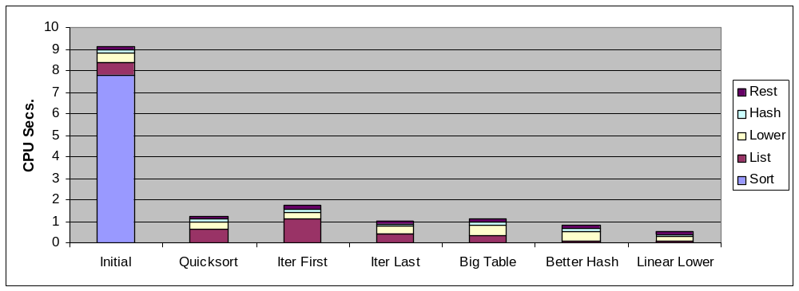
Code Optimizations
  First step: Use more efficient sorting function
  Library function qsort

Slide 81
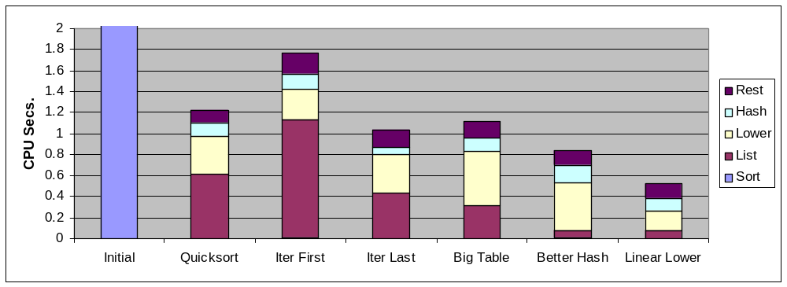
Further Optimizations
  Iter first: Use iterative function to insert elements into linked list
    Causes code to slow down
  Iter last: Iterative function, places new entry at end of list
    Tend to place most common words at front of list
  Big table: Increase number of hash buckets
  Better hash: Use more sophisticated hash function
  Linear lower: Move strlen out of loop

Slide 82
Profiling Observations
Benefits
  Helps identify performance bottlenecks
  Especially useful when have complex system with many components
Limitations
  Only shows performance for data tested
  E.g., linear lower did not show big gain, since words are short
    Quadratic inefficiency could remain lurking in code
  Timing mechanism fairly crude
    Only works for programs that run for > 3 seconds

Slide 83
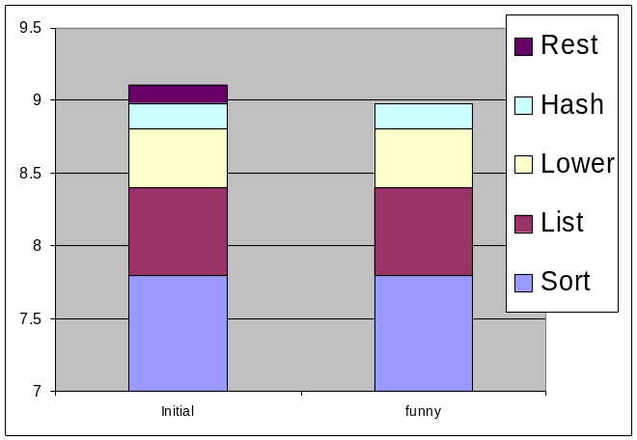
How Much Effort Should we Expend?
Amdahl’s Law:
Overall performance improvement is a combination
  How much we sped up a piece of the system
  How important that piece is!
Example, suppose Chose to optimize “rest” & you succeed! It goes to ZERO seconds!

Slide 84
How Much Effort Should we Expend?
Amdahl’s Law:
Overall performance improvement is a combination
  How much we sped up a piece of the system
  How important that piece is!
Example, suppose Chose to optimize “rest” & you succeed! It goes to ZERO seconds!
Amdahl’s Law
  Total time = (1-α)T + αT
  Component optimizing takes αT time.
  Improvement is factor of k, then:
  T_{new} = T_{old}[(1-α) + α/k]
  Speedup = T_{old}/T_{new} = 1/ [(1-α) + α/k]
  Maximum Achievable Speedup (k = ∞) = 1/(1-α)

Slide 85
Role of Programmer
  How should I write my programs, given that I have a good, optimizing compiler?
Don’t: Smash Code into Oblivion
  Hard to read, maintain, & assure correctness
Do:
  Select best algorithm
  Write code that’s readable & maintainable
    Procedures, recursion, without built-in constant limits
    Even though these factors can slow down code
  Eliminate optimization blockers
    Allows compiler to do its job
Focus on Inner Loops
  Do detailed optimizations where code will be executed repeatedly
  Will get most performance gain here

